Slide 1
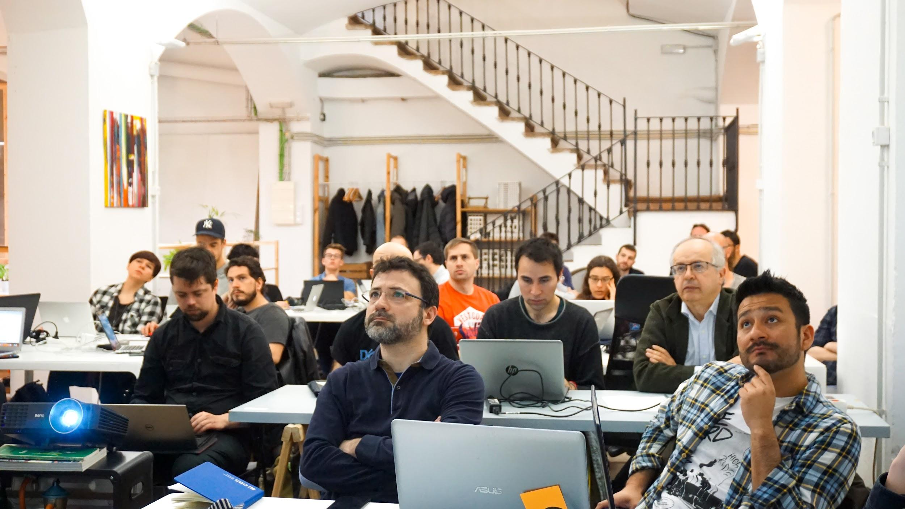

Intro to Machine Learning
Providing universal access to AI education and practice

Slide 2


What is Data Science?
Data science, also known as data-driven science, is an interdisciplinary field about scientific methods, processes and systems to extract knowledge or insights from data in various forms, either structured or unstructured.

Slide 3

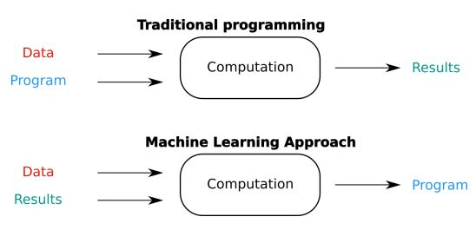
What is Data Science?

Slide 4
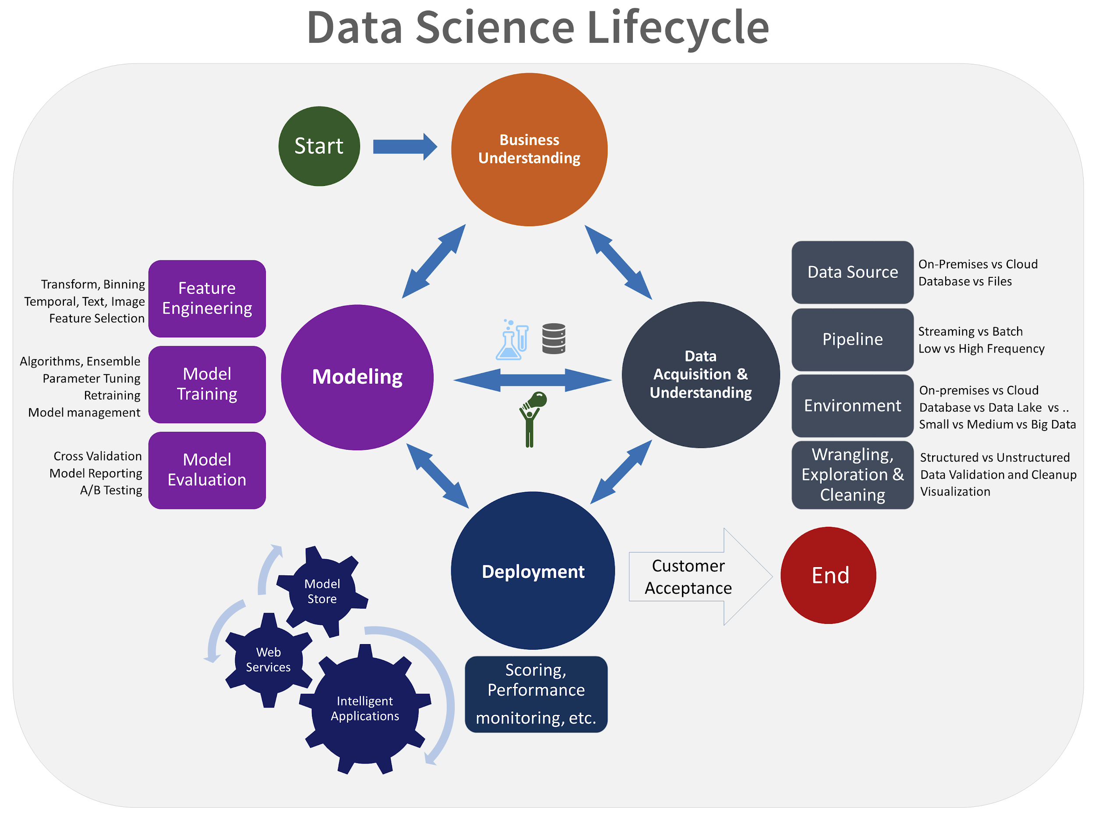
How is the traditional flow of Data Science?
Business Problem
Data Acquisition
Data Preparation
. . .
Data Analysis
Data Modelling
Visualization and Communication
Deployment and maintenance

Slide 5
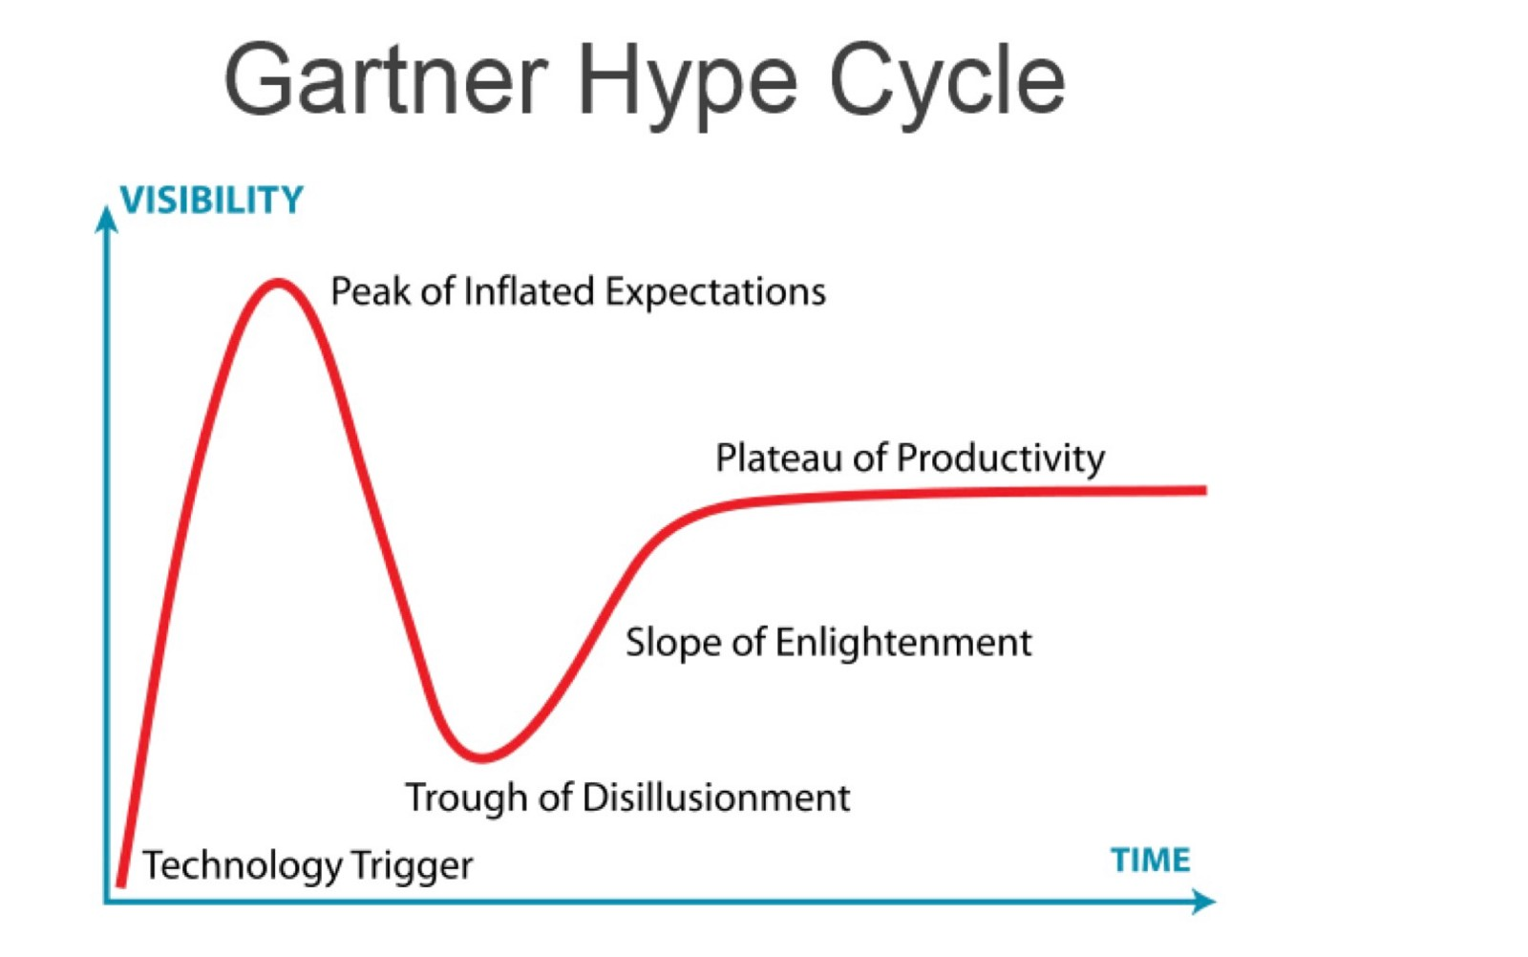
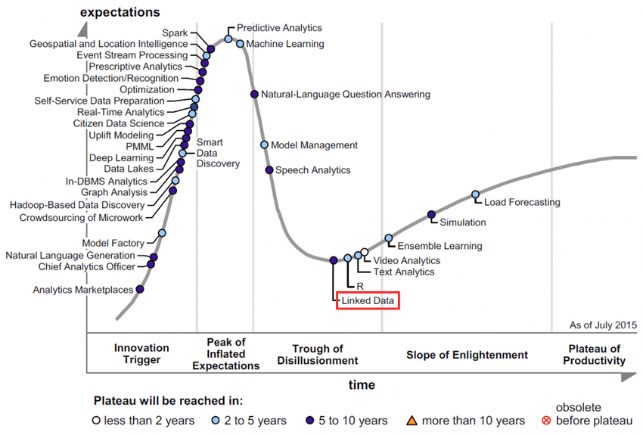

Data Science is so hyped right now...

Slide 6
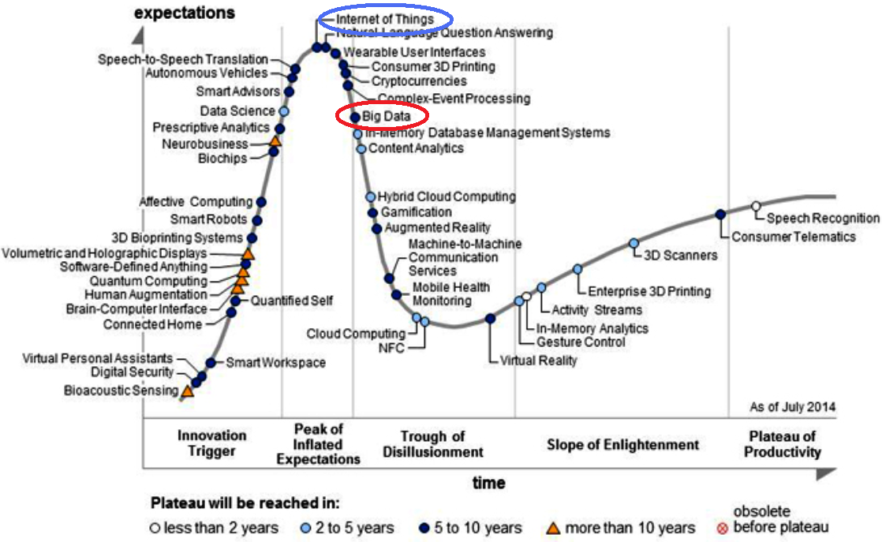
These graphs are also hyped...

Slide 7
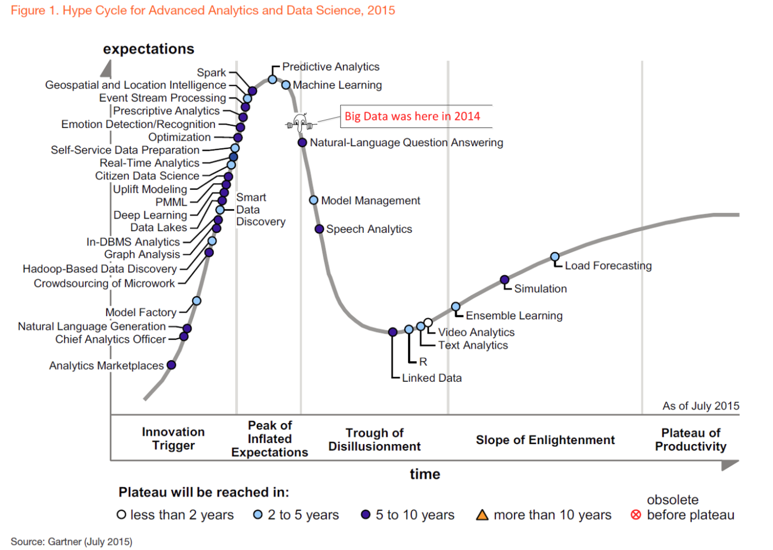
These graphs are also hyped...

Slide 8
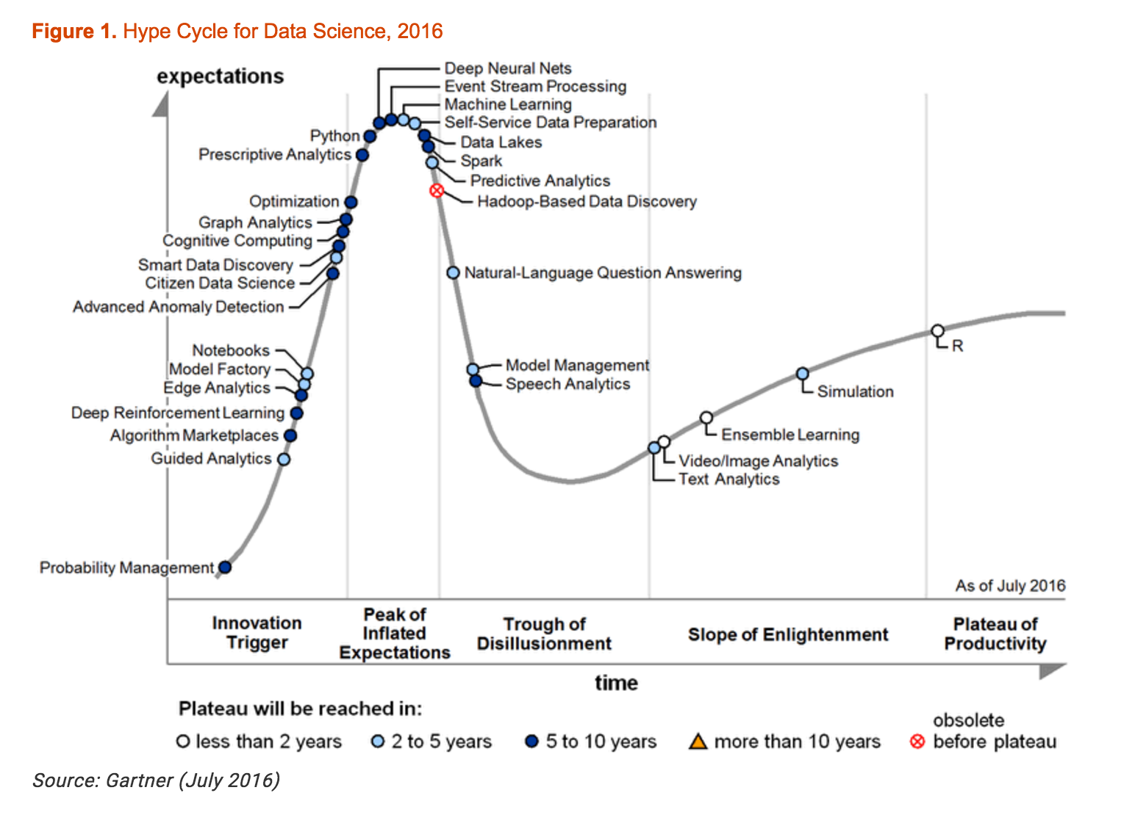
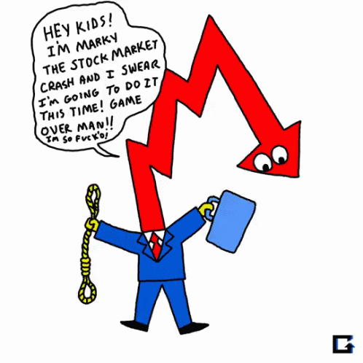
These graphs are also hyped...

Slide 9
Why the hype in Data Science?
Curious to hear your thoughts

Slide 10
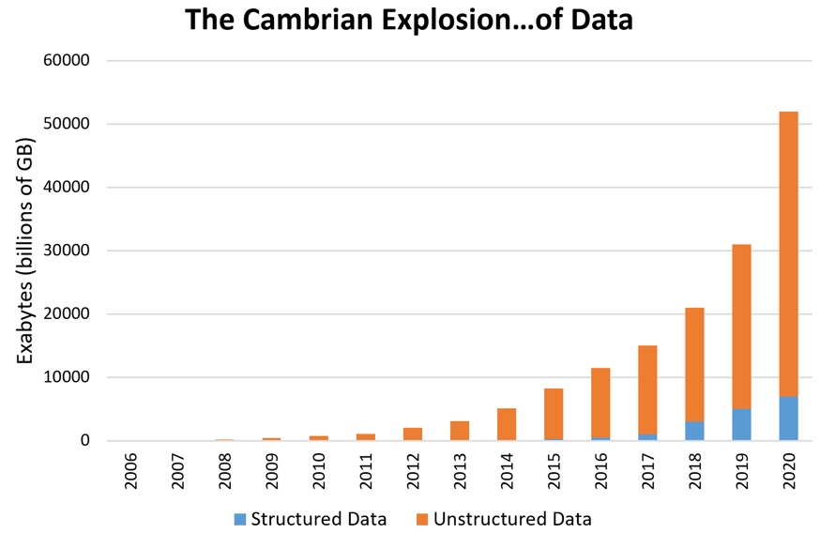
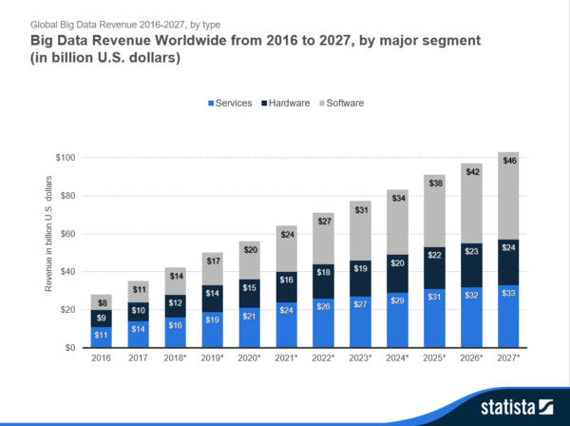
Why the hype in Data Science?

Slide 11
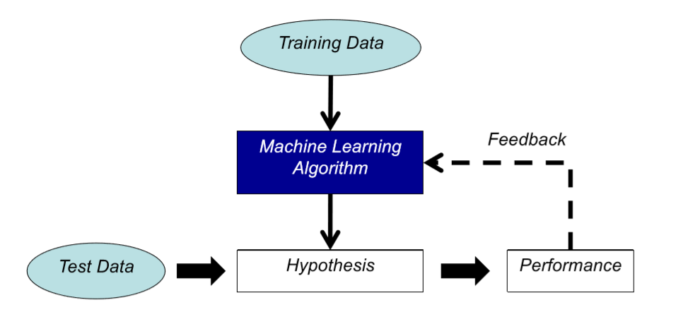
The true Data Science enabler: ML
Machine Learning: Field of study that gives the computer the ability to learn without being explicitly programmed - Arthur Samuel (1959)
Okay so… What is learning?
By dictionary definition: To gain knowledge or understanding of,
or skill in by study, instruction or experience”
• Learning a set of new facts
• Learning HOW to do something
• Improving ability of something already learned

Slide 12
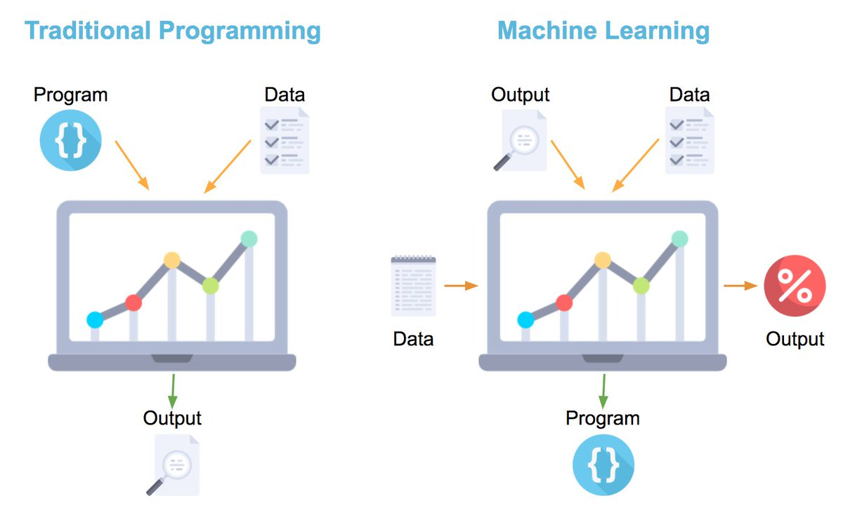
Traditional Programming vs ML

Slide 13






How do humans learn?
KNOWLEDGE & INSTINCT
DATA
DECISION

Slide 14
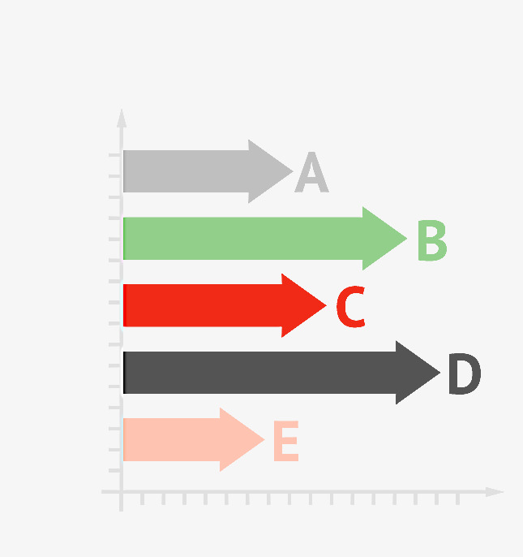


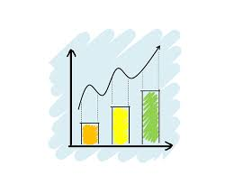
How can machines learn? (simplified)
DATA
KNOWLEDGE
DECISION

Slide 15
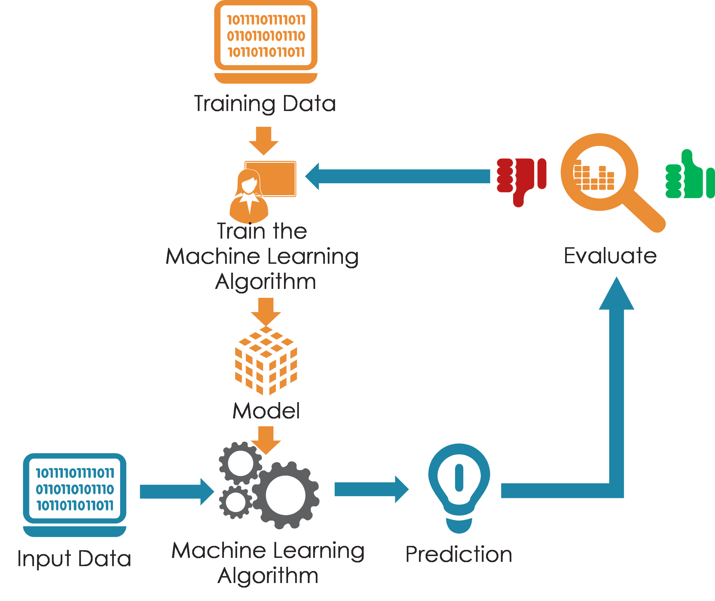
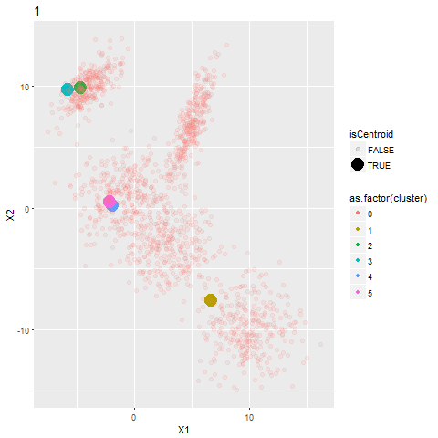
Machine learning process

Slide 16

When to not use Machine Learning
Option 1: Manual Counting
Cost: 4h+ and Anxiety
Precision: 100%
Option 2: Weighting
Cost: 10’ + smile
Precision: 99.5%
Option 3: Machine Learning
3 days to design coin recognition engine
Computing power & not 100% prec.

Slide 17
When to not use Machine Learning
Option 1: Manual Counting
Cost: 4h+ and Anxiety
Precision: 100%
Option 2: Weighting
Cost: 10’ + smile
Precision: 99.5%
Option 3: Machine Learning
3 days to design coin recognition engine
Computing power & not 100% prec.

Slide 18

Machine Learning drawbacks:
Expensive to implement
Requires high domain expertise
Can generate additional bias
Can act as a black box
Don’t fish with dynamite…
… if you can avoid it

Slide 19
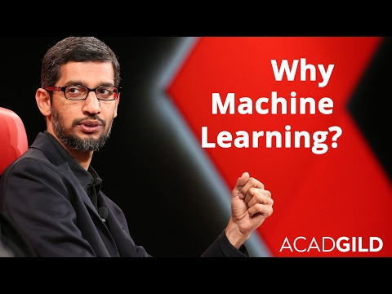
Why use Machine Learning?
Develop systems that are too difficult or expensive to construct manually because they require specific detailed skills or knowledge tuned to a specific task (knowledge engineering bottleneck). How to we synthesise new proteins?
Develop systems that can automatically adapt and customize themselves to individual users (personalization). How does your inbox filter spam?
Discover new knowledge from large databases (datamining).
How does each one of you surf youtube?

Slide 20

Why should you study Machine Learning?
Many basic effective and efficient algorithms available
Large amounts of online data available
Large amounts of computational resources available
Being in the right space matters more than doing exactly the right thing.
Startup in SF vs Startup Elsewhere in the world
Think about internet companies on 1998
Gold Mining in California
Hopefully we have also proved that this not a hype.

Slide 21
Machine Learning Definition
Study of algorithms that given a task T, they improve their performance P based on experience E.
In a way, learning implies : <T,P,E>
Some examples:
T: Handwritten words recognition
P: Percentage of words identified correctly
E: Database of handwritten words
T: Driving autonomously using LIDAR
P: Average distance covered before a mistake
E: Sequence of images and direction commands recorded while a human was driving (millions of km and data actually)

Slide 22
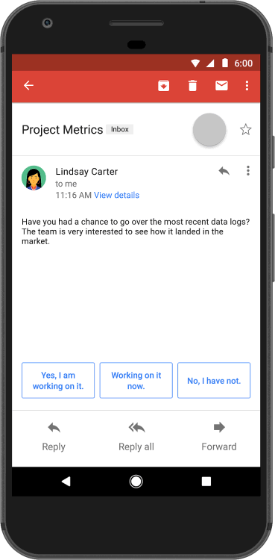
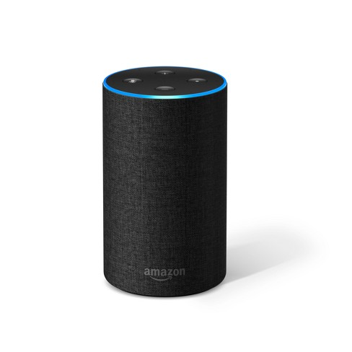
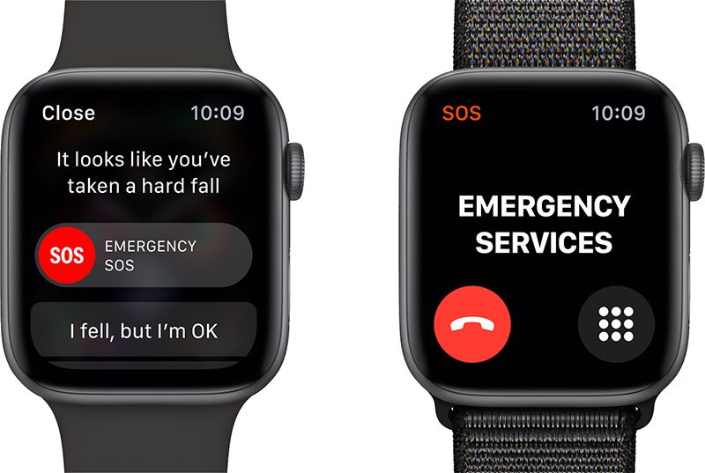
Machine Learning Examples
Study of algorithms that given a task T, they improve their performance P based on experience E.
Let’s think of some : <T,P,E>

Slide 23

Machine Learning in your Projects
Study of algorithms that given a task T, they improve their performance P based on experience E.
Let’s think of some : <T,P,E> …. With your projects!
Do you already know what you would like to do? Let’s think of at least a field.

Slide 24
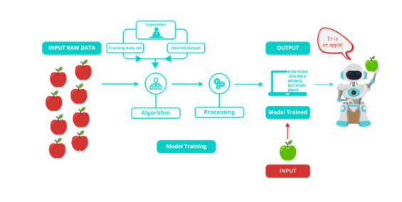
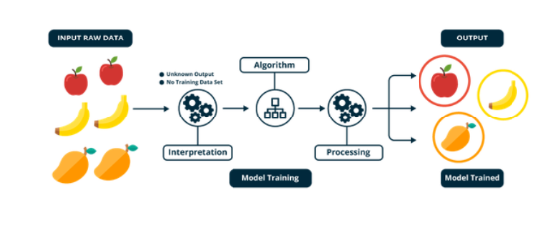
Two types of machine learning
Supervised Learning
Labelled data
Classification
Regression
Self-supervised Learning
Pattern Discovery
Clustering
Anomaly detection

Slide 25

Fast Machine Learning Overview

Slide 26
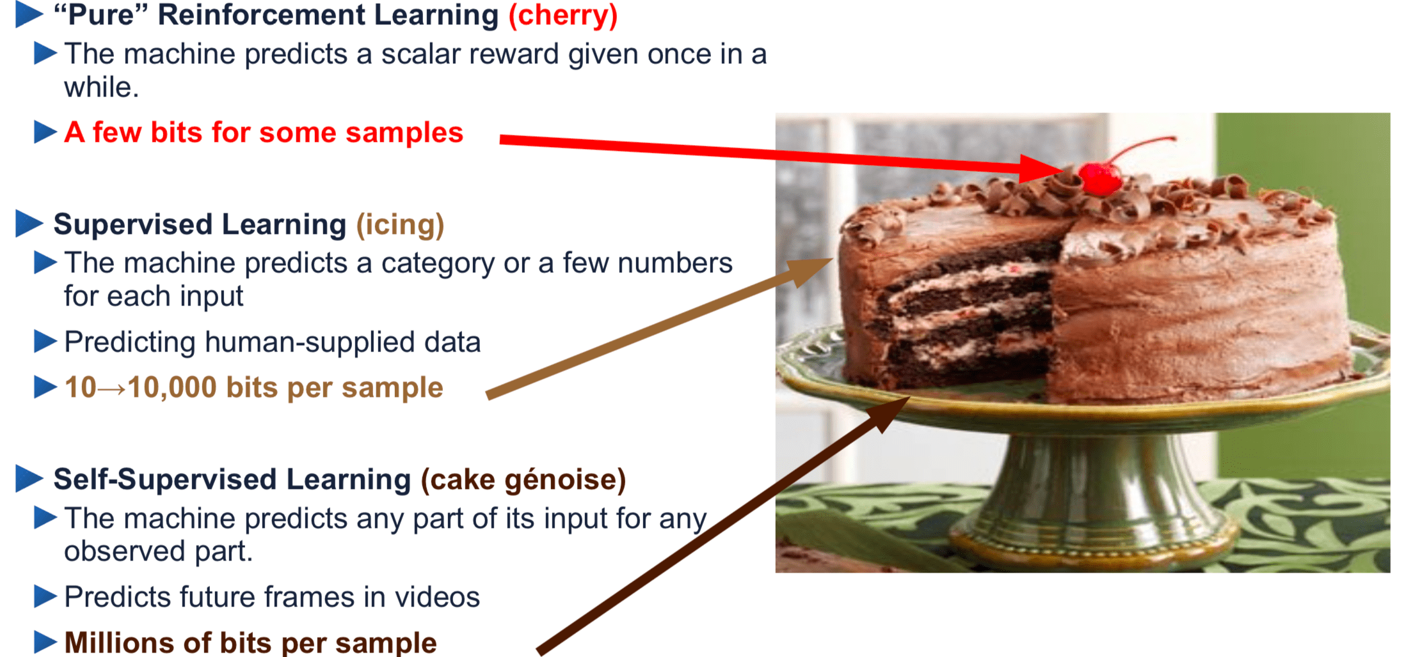
Actually, this is a lie. There’s at least 3 types
Bits = Information needed by the Machine Learning system

Slide 27
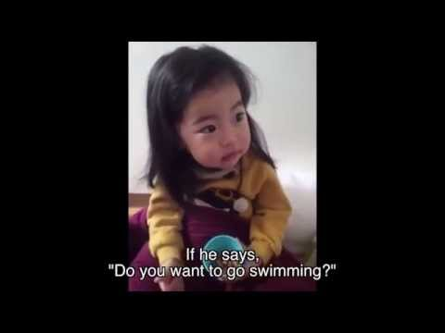

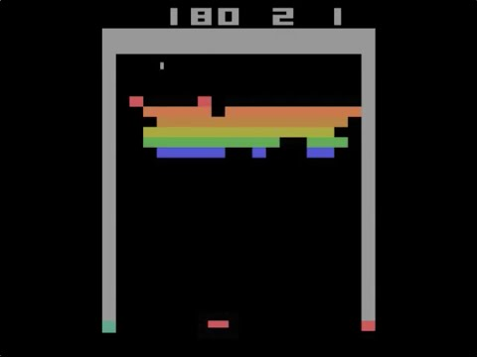
Three Examples

Slide 28
Designing a Machine Learning System
Steps:
Picking the data (training experience)
Picking what we want to learn (target function)
Choosing how to represent the target function
Picking a learning algorithm to infer the target function from the training experience.

Slide 29
Maths for Machine learning
Selecting the right algorithm which includes giving considerations to accuracy, training time, model complexity, number of parameters and number of features.
Choosing parameter settings and validation strategies.
Identifying underfitting and overfitting by understanding the Bias-Variance tradeoff.
Estimating the right confidence interval and uncertainty.

Slide 30
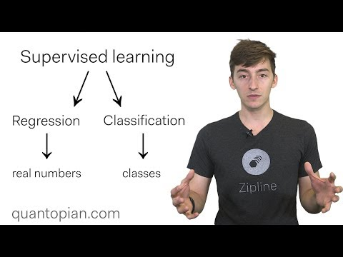
Relevant Concepts
What is a task?
Classification
Regression
Problem solving / planning / control
How to evaluate performance?
Classifying the right answers (or error)
The validity of the solution
Quality of the solution
Performance velocity
How to represent experience?
Neurons, cases, decision trees, etc
Tomato example

Slide 31
Influences to Machine Learning
Models of intelligence
– Cognitive Psychology: The process of human learning
– Neurobiology: The brain, the neuron
Knowledge/concepts – Cognitive Psychology: What is a concept? How to represent them? Is there an explanation about how we represent them? – Mathematical Logic: How concepts can be combined and manipulated? – Statistics: What mathematical model represents them? – Information theory: How can we code them?

Slide 32
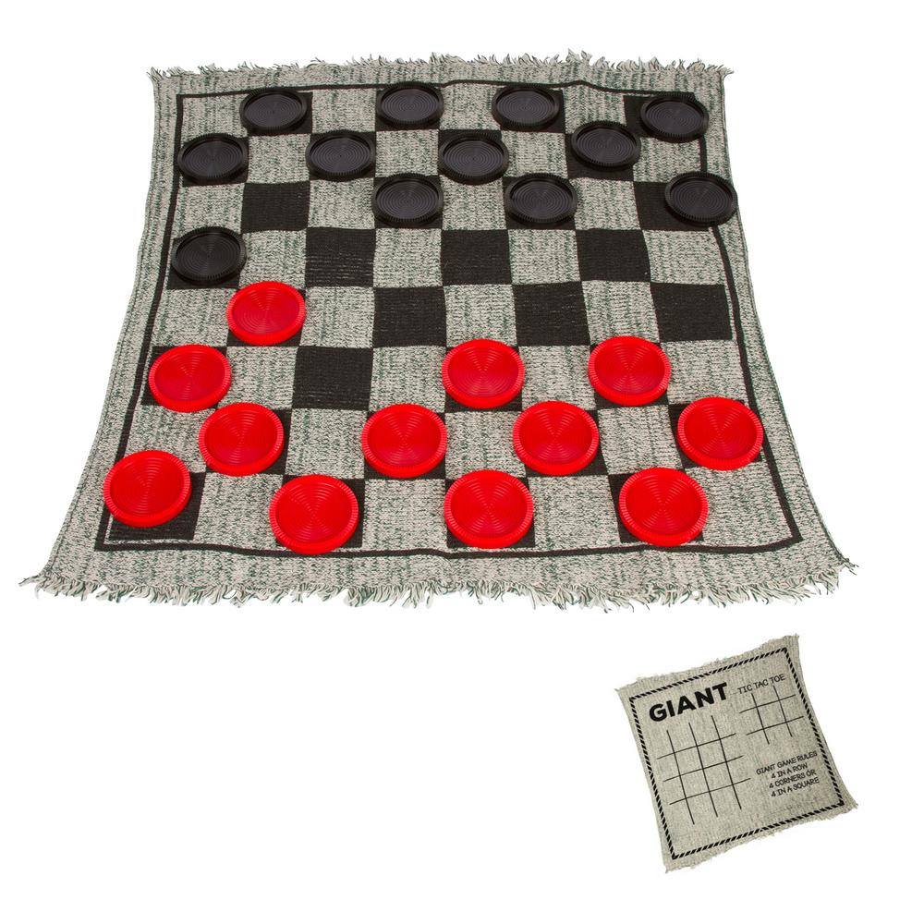
Sample Learning Problem
Learn to play checkers from self-play
We will develop an approach analogous to that
used in the first machine learning system
developed by Arthur Samuels at IBM in 1959

Slide 33


Influences to Machine Learning
Direct experience: Given sample input and output pairs for a useful target function.
– Checker boards labeled with the correct move, e.g. extracted from record of expert play
Indirect experience: Given feedback which is not direct I/O pairs for a useful target function.
– Potentially arbitrary sequences of game moves and their final game results.

Slide 34
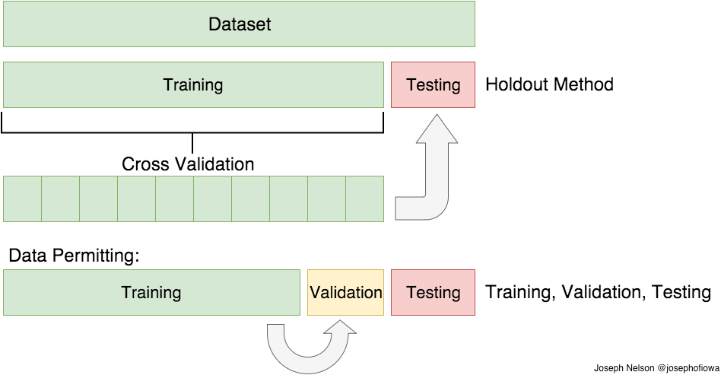
Train / Test Split
Like practicing for an exam with class exercises. Seeing the exam first would defeat the learning challenge

Slide 35
Choosing a target function
What function is to be learned and how will it be used by the performance system?
For checkers, assume we are given a function for generating the legal moves for a given board position and want to decide the best move.
– Could learn a function:
ChooseMove(board, legal-moves) → best-move
– Or could learn an evaluation function,
V (board) → R,
that gives each board position a score for how favorable it is

Slide 36
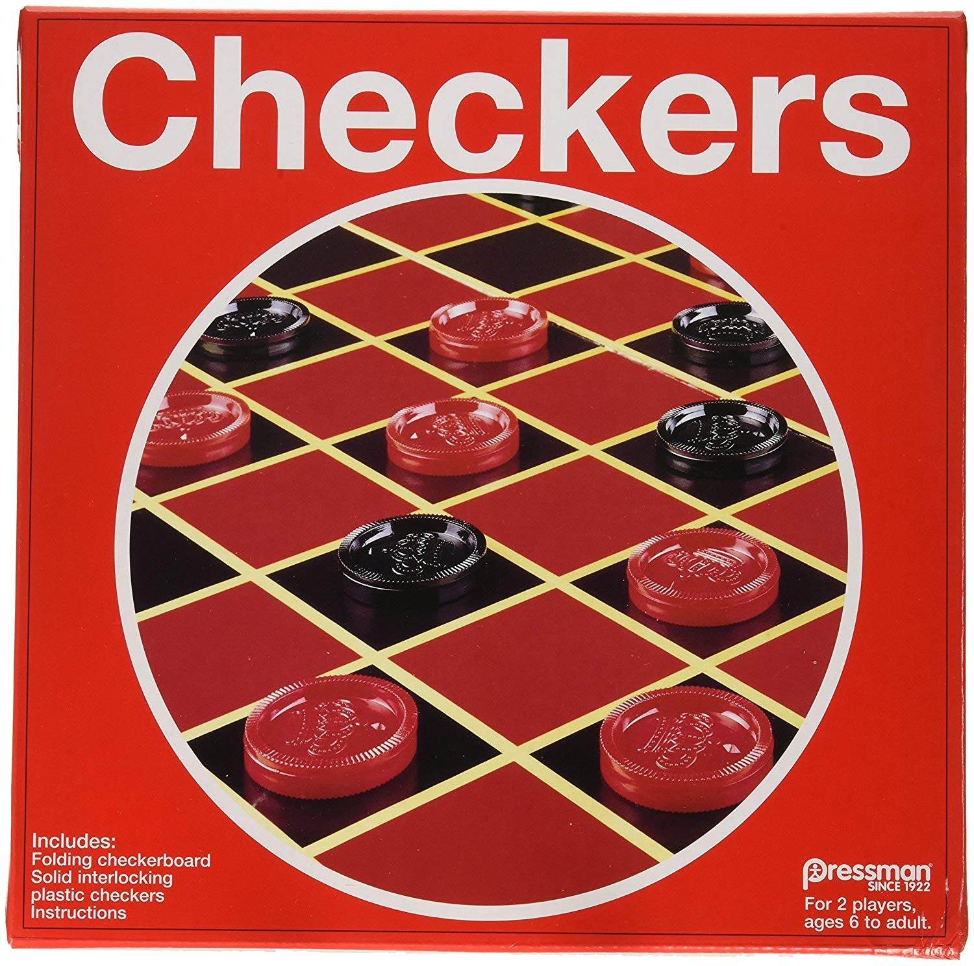
Ideal definition of V(board)
If b is a final winning board, then V(b) = 100
If b is a final losing board, then V(b) = –100
If b is a final draw board, then V(b) = 0
Otherwise, then V(b) = V(b ́), where b ́ is the
highest scoring final board position that is
achieved starting from b and playing optimally
until the end of the game (assuming the
opponent plays optimally as well).

Slide 37
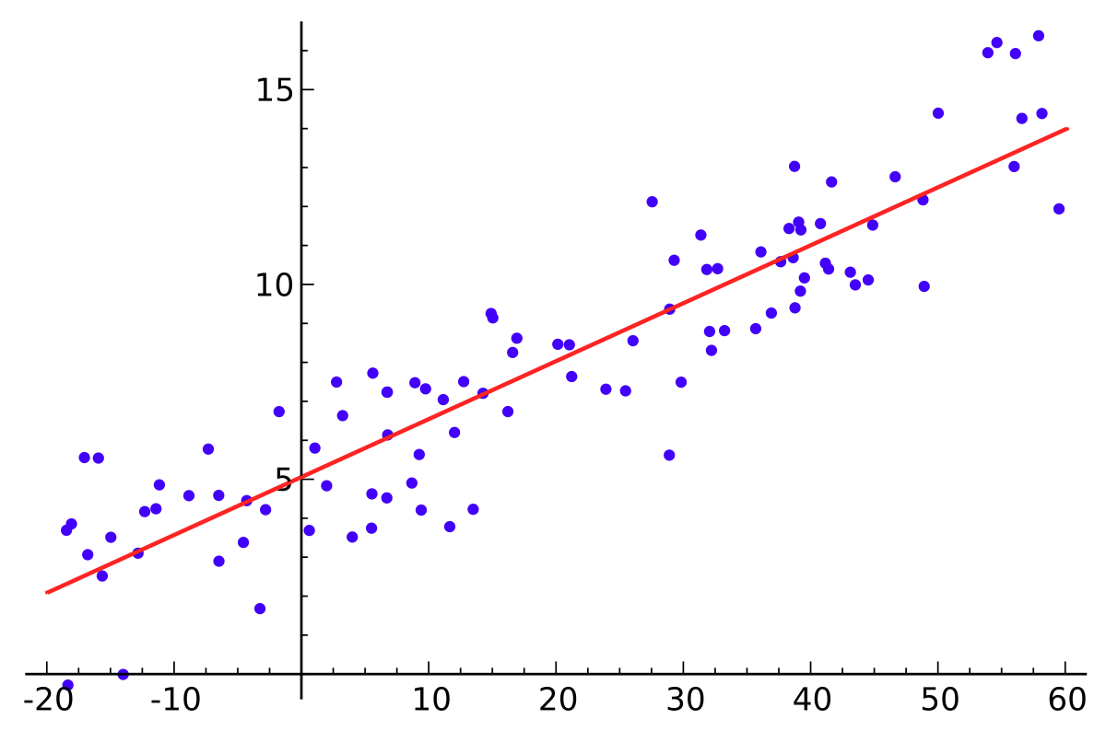
Target function
Which function must be learned and how will it be used in the system to incentivize performance?
Target function can be represented in many
ways: lookup table, symbolic rules, numerical
function -like in the picture- or neural network among others.
There is a trade-off between the expressiveness
of a representation and the ease of learning.

Slide 38
Linear Function for Representing V(b)
In checkers, use a linear approximation of the
evaluation function.
bp(b): number of black pieces on board b
– rp(b): number of red pieces on board b
– bk(b): number of black kings on board b
– rk(b): number of red kings on board b
– bt(b): number of black pieces threatened (i.e. which
can be immediately taken by red on its next turn)
– rt(b): number of red pieces threatened

Slide 39
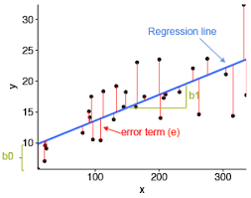
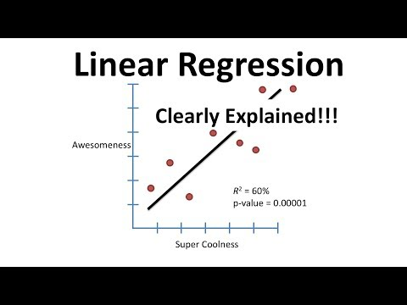
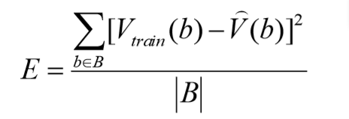
Learning Algorithm
Uses training values for the target function to induce a hypothesized definition that fits these examples and hopefully generalizes to unseen examples.
In statistics, learning to approximate a continuous function is called regression. Attempts to minimize some measure of error
(loss function) such as mean squared error:

Slide 40
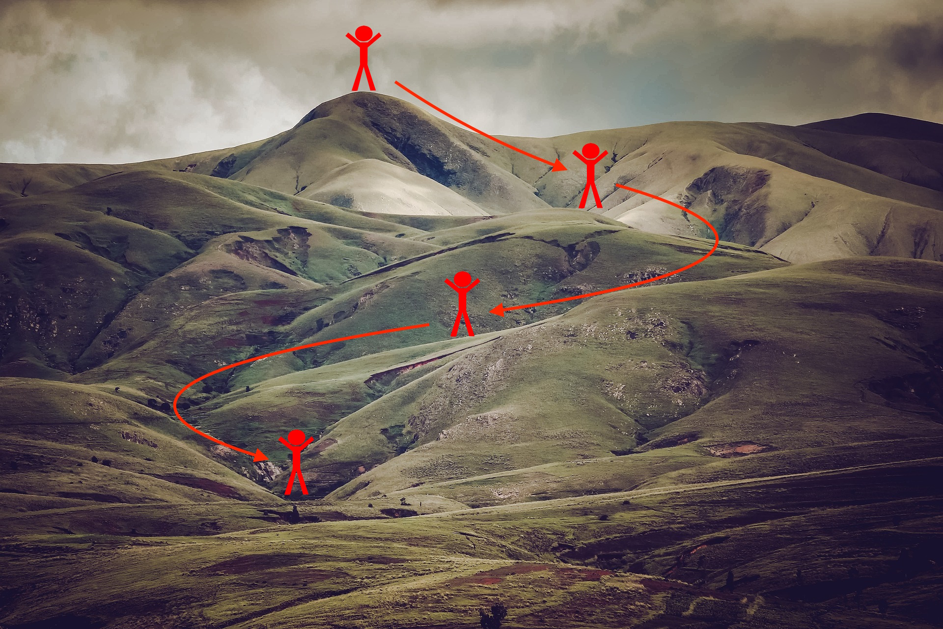
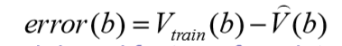
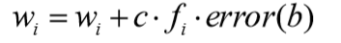
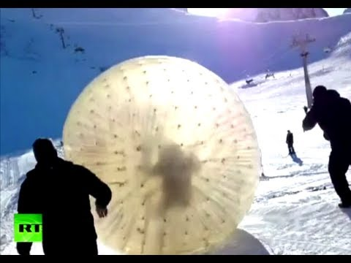
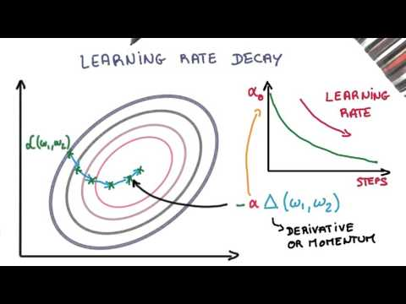
Gradient Descent Algorithm
The gradient descent algorithm updates incrementally the weights of a linear function in an attempt to minimize the mean squared error.
Repeat until the points converge:
For each element of training b:
Calculate the absolute error:
For each component of the function, update its weight:
c is the learning rate

Slide 41
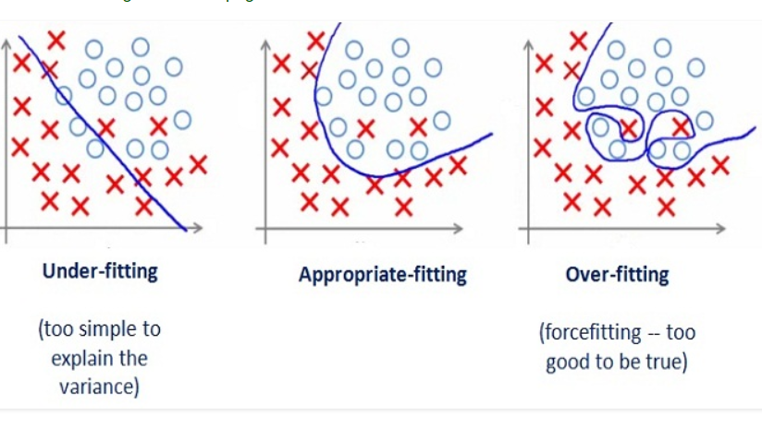
Under-fitting and Overfitting

Slide 42
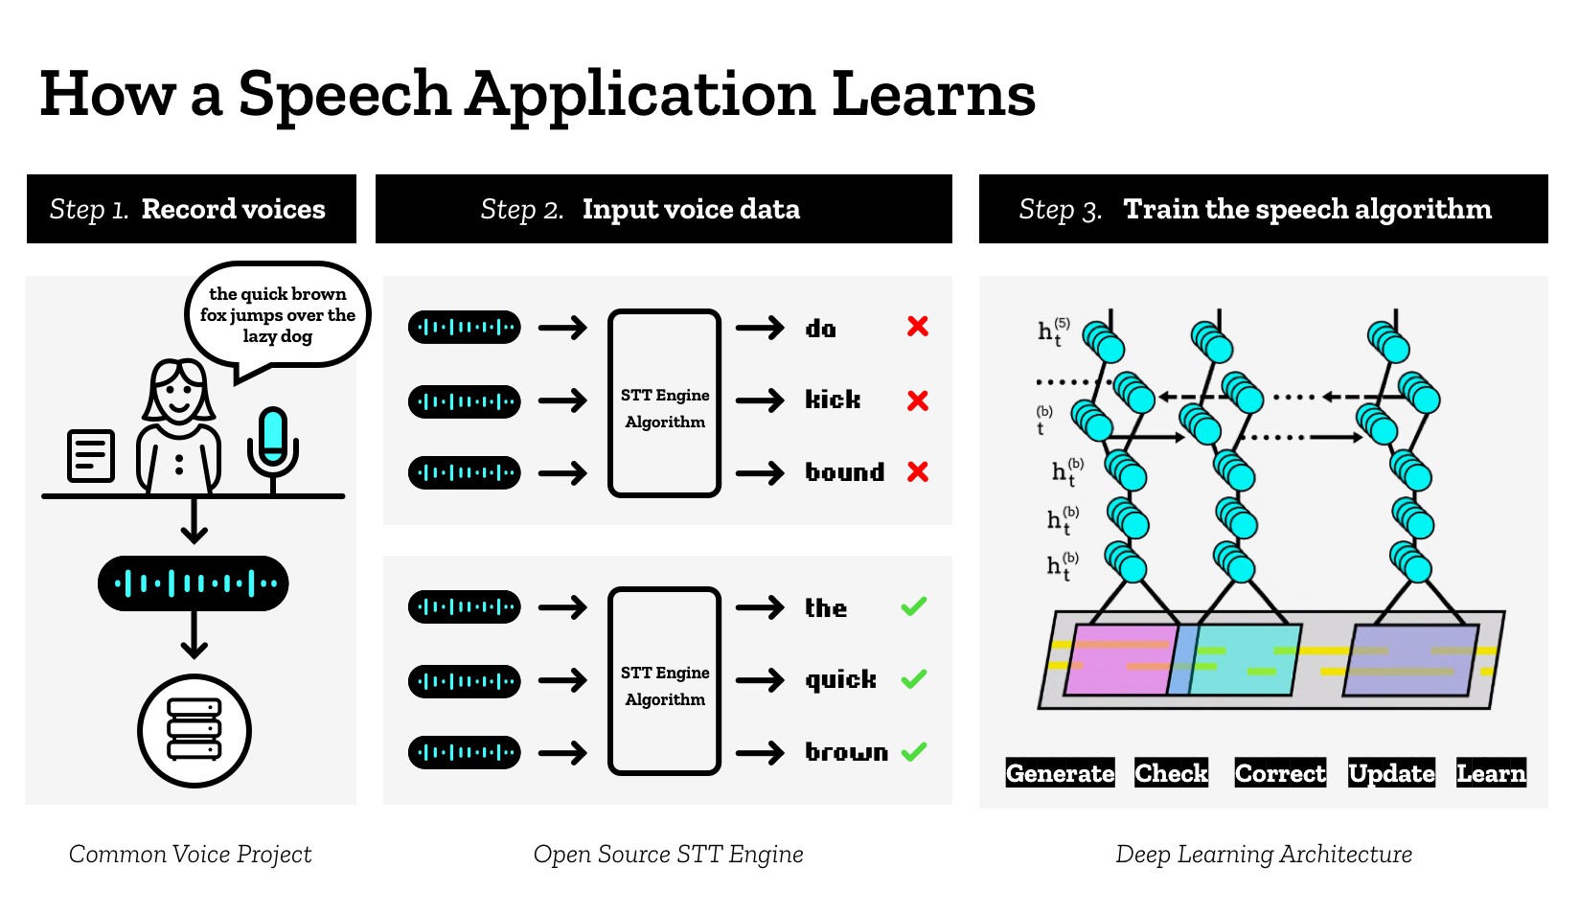
Example: Speech Application

Slide 43
To review and summarize: Learning
Learning can be viewed as using direct or indirect experience to approximate a chosen target function.
Function approximation can be viewed as a search through a space of hypotheses (representations of functions) for one that best fits a set of training data.
Different learning methods assume different hypothesis spaces (representation languages) and/or employ different search techniques.

Slide 44
To review and summarize: ML Process
Data collection and Preparation
Feature Selection
Algorithm Choice
Parameter and model selection
Training
Training Data
Evaluation

Slide 45
To review and summarize: Types of ML

Slide 46


Introduction to Sklearn
Sklearn is the Swiss knife of machine learning, it comes with dozens of models out of the box and a huge community. It is not the most powerful knife but great to get started. There is also an awesome set of tutorials.
Sklearn comes installed with the conda environment. In other scenario we need to install it by means of pip (which we won’t), to install it we just need to run:
conda install scikit-learn

Slide 47
Sklearn: Types of Models
Models in sklearn are imported separately as for example.
from sklearn.ensemble import RandomForestClassifier
Inside of sklearn we will ﬁnd diﬀerent types of models. I will just introduce the high level API of them:
Supervised models to perform predictions.
Self-supervised models to group data automatically.
Transformation models to perform transformations in the data

Slide 48
Sklearn: Supervised Models
This kind of models are the most intuitive ones. You train them with data and expected outputs and later it will predict outputs for unseen data. To train the algorithm we call the fit method and to predict with it we call the predict function
from sklearn.ensemble import RandomForestClassifier
clf = RandomForestClassifier().fit(X, y)
clf.predict(X)

Slide 49
Sklearn: Supervised Models
This kind of models are the most intuitive ones. You train them with data and expected outputs and later it will predict outputs for unseen data. To train the algorithm we call the fit method and to predict with it we call the predict function
from sklearn.ensemble import RandomForestClassifier
clf = RandomForestClassifier().fit(X, y)
clf.predict(X)

Slide 50
Sklearn: Self-supervised Models
Other type of models, in this case it will not predict but ﬁnd groups of similar elements inside data. To train the algorithm we call the fit method and to get the group of an unseen element we call the predict method
from sklearn.cluster import KMeans
clf = KMeans().fit(X)
clf.predict(X)

Slide 51
Sklearn: Transformation models
This last kind of models transform our data. For example for dimensionality reduction tasks or normalization tasks. Their main method is fit_tranform
from sklearn.preprocessing import MinMaxScaler
transformed_data = MinMaxScaler().fit_transform(X)

Slide 52

Coding demo
Notebook

Slide 53
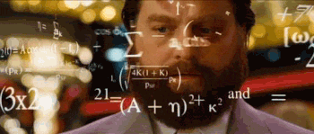
Exercise time!

Slide 54
Reviewing last week concepts (self correcting NBs)
Tensor Data Management
Data Analysis
Iris Dataset
Harder Challenge: Fashion MNIST

Slide 55
2) Classification Exercise
Classification Exercise
Given a dataset, make a program using the sklearn library, that divides the dataset in two parts, one for training and another for testing and train a classification algorithm of your choice from Sklearn (like SVM_Classification) to correctly classify the dataset.
1.- Iris dataset (load_iris)
2.- Wine dataset (load_wine)

Slide 56
3) Regression Exercise
Given the Boston dataset (load_boston), do a program using the library sklearn, that divides the dataset in two parts (one for training and another one for testing) and train the algorithm of regression to predict the housing prices given the missing values.
Harder Challenge: Boston Notebook (self-graded but with harder challenges)
Tip
-If there is some variable that is not correlated with the objective result, you can erase it to simply the algorithm in order to work in less dimensions.

